Slide 1
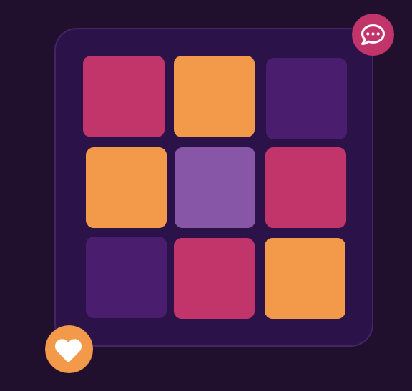

AN INSTAGRAM (IG_CLONE) SQL ANALYSIS
The Story of Social Media Analysis
A Data-Driven Story of Engagement & Growth
How photos, likes, comments, follows and tags reveal who Instagram’s most valuable users are, and how to keep them.
Sumit Suprabhat Bhatia
Newton School SQL Project - January 2026 Batch

Slide 2





Agenda
1. About Instagram and Problem Statement
2. Database schema and Data Description
3. User Activity & Engagement Patterns
4. Hashtags and Content themes
5. Loyalty, influencer scores and rewards
6. Key insights and recommendations

Slide 3



About Instagram
Instagram launched in 2010 as a simple photo-sharing app, now a core pillar of Meta’s Family of Apps.
Built around four core actions: post, like, comment, follow - the exact mechanics this analysis is built on.
Meta reports Instagram now reaches well over 3 billion monthly active users worldwide, making engagement data one of the richest behavioural datasets in tech.
The ig_clone database mirrors this structure at small scale: 7 tables, the same core mechanics, ready to mine for insight.
Post
Like
Comment
Follow
3B+
Monthly active users worldwide for Meta in 2026

Slide 4
Problem Statement
THE ROLE
“You are hired as a data analyst at Meta and asked to collaborate with the Marketing team.”
THE CHALLENGE
The Marketing team wants to leverage Instagram’s user data to develop targeted marketing strategies that will increase
User engagement
Retention
Acquisition
Provide insights and recommendations to address these three core objectives.
ig_clone dataset

Slide 5
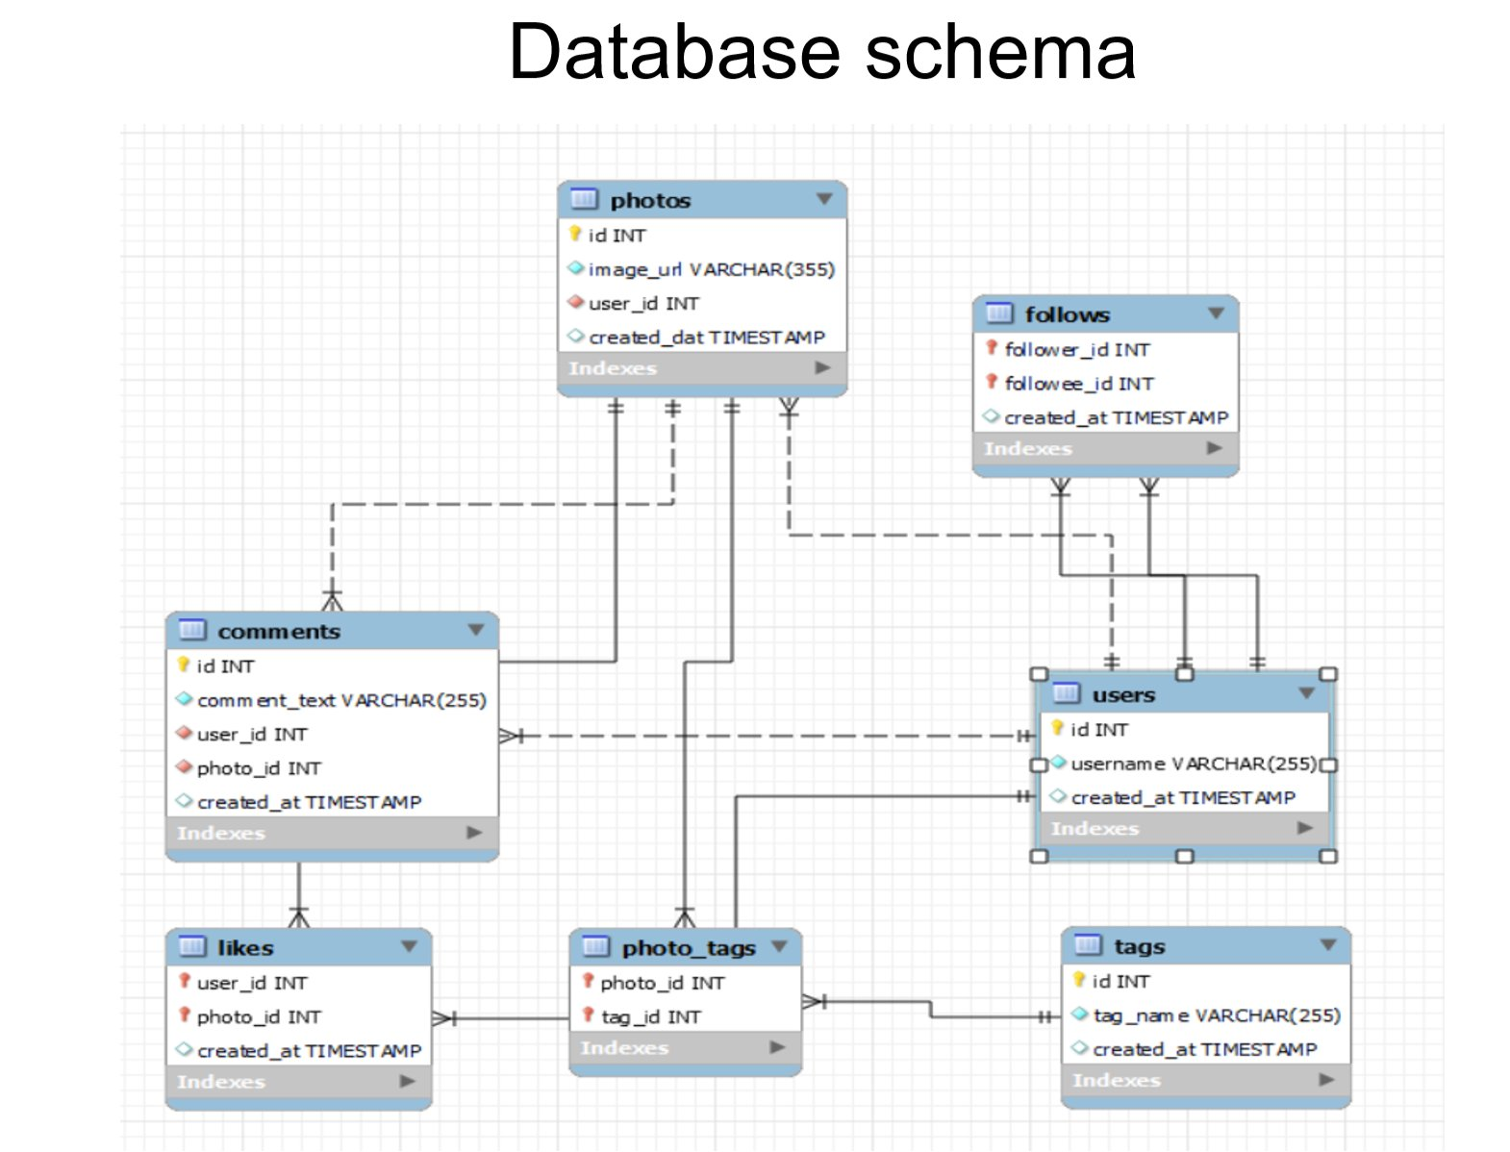
Database Schema, Seven Connected Tables
users: Every account on the platform
photos: Posts uploaded by users
likes: Who liked what, and when
comments: Text replies on posts
follows: Follower → followee links
tags: The hashtag library
photo_tags: Hashtags mapped to posts

Slide 6
Data Description
comments_id: Unique identifier for each comment
user_id : Unique identifier for each user
created_at: Date of interaction (like, photo, tag)
followee_id: user_id of the followee for a given user
image_url: Link to the image posted on the platform
comment_text: Text content of a given comment
photo_id: Unique identifier for each photo
follower_id: user_id of the follower for a given user
tag_id: Unique identifier for each tag
username: Username chosen by the user

Slide 7
Data Quality Check
No NULL values found across every table in the database.
No duplicate records detected in any table.
Clean & Analysis-Ready: No cleansing required before diving into the analysis ahead.
Reliable engagement metrics: Likes, comments, follows and tags can be trusted at face value.
Accurate user analysis: Activity scores and loyalty rankings stay undistorted.
Reduced cleaning effort: Minimal preprocessing before advanced analytics.

Slide 8
User Activity Levels
Posts, likes and comments were combined into an activity score, then used to sort every account into one of four behavioural tiers - from power users to dormant accounts.
Power Users: The most active creators and engagers - they drive a disproportionate share of platform activity.
Highly Active Users: Frequent posters and engagers who keep the feed alive day to day.
Moderately Active Users: Already engaging with the platform - prime candidates to grow into highly active users.
Inactive Users: No meaningful posts, likes or comments - a churn-risk segment that needs re-engagement.

Slide 9
Engagement vs Upload Frequency
Low Frequency → 1-3 uploads
Medium Frequency → 4-8 uploads
High Frequency → 9-12 uploads
Total engagement received, by creator upload frequency.
Average engagement per photo - stays near 60-66 regardless of volume.

Slide 10
Followers vs Followings
FOLLOWERS ↑
77 highest follower count recorded on the platform.
99 highest following count – the platform’s most exploratory user.
Influencers
Community Builders
High followers, low following
High followers, high following
Comparing the two metrics separates true influencers from highly social, exploratory users - each needing a different marketing approach.
Quiet Observers
Content Consumers
Low followers, low following
Low followers, high following
FOLLOWING →

Slide 11
Hashtag Usage
1.95 average hashtags attached to every single post
#dreamy - 35.75 average likes, the single best-performing hashtag on the platform
Tagging behaviour is a direct signal of discoverability: posts with relevant, well-chosen hashtags surface in search and recommendations more often. With tagging averaging under 2 per post, there's clear headroom to nudge creators toward richer, more strategic hashtag use - and #dreamy shows exactly the kind of content that pays off.

Slide 12
Top Performing Hashtags
Food content dominates - #foodie, #delicious and #food all rank in the top 6.
Beauty & aesthetic tags (#beauty, #stunning, #dreamy, #smile) perform almost as strongly.
#delicious ranks #1 with only 15 posts - quality beats posting volume.
#smile has the largest total reach (59 posts, 3,758 total engagement) despite a lower average.

Slide 13
Interest Categories and Ad Targeting
Hashtags users engage-with were grouped into broad user’s interest categories. The top 3 hashtag categories for each user reveal exactly which ad types will resonate.
Food: Restaurants, delivery apps, cuisine brands
Fashion: Clothing brands & retailers
Travel: Airlines, hotels, holiday packages
Beauty: Cosmetics & skincare brands
Photography: Cameras & editing apps

Slide 14
User Segments
58% are Highly Engaged - a healthy, active core community, prime candidate to convert into creators.
Only 12% are Content Creators - a small group fuels most content; protect them.
13% are Active Consumers - prime candidates for first post campaign.
13% are Inactive Users - a real churn risk without intervention.
4% are Casual Consumers - periodic engagement with growth potential.

Slide 15
Users With No Engagement
23 users have never liked a single post on the platform.
13 users are fully inactive - zero posts, likes, or comments.
Possible causes:
New users who haven’t explored the platform yet.
Passive content consumers who scroll without interacting.
Dormant or abandoned accounts.
Suggested actions:
Personalized welcome campaign highlighting trending posts & creators.
First-post incentive badge to spark initial activation.
Smart follow recommendations to build social connections.
Content discovery surfaced immediately after login.

Slide 16
Loyalty Score and Rewards
Loyalty Score formula
Recommended rewards:
Verified badges & featured explore-page placement for top creators.
Early access to new features and beta programs.
Brand partnership & monetization opportunities.
Exclusive channel invites and priority stories for community contributors.
Comments received 25%
Comments made 25%
Likes received 20%
Likes given 17%
Posts 10%
Followers 3%
Comments outweigh likes - they take more effort and signal deeper engagement. Followers count for almost nothing, keeping the score about behaviour, not audience size.
169.76 Eveline95’s loyalty score - 420 likes & 329 comments received.
110.22 Janelle.Nikolaus81’s score - 257 likes & 257 comments given.

Slide 17
Influencers & Brand Ambassadors
Ambassador Score formula
How to collaborate:
Pay for performance - reward engagement and conversions, not follower count alone.
Co-created content - let influencers post in their own authentic style.
Launch an ambassador program for the top 10-15 users by Ambassador Score.
Use ambassadors to pilot new features like Reels and hashtag challenges.
Followers 30%
Comments received 30%
Likes received 20%
Posts created 10%
Likes given 5%
Comments made 5%
Across the board, follower counts barely vary (76-77). High engagement quality, not audience size separates real influencers from the rest.
Top-ranked influencer: Meggie_Doyle with 75.00 engagement rate and 68.00 influencer score.

Slide 18
Key Insights
A clean foundation: Zero NULLs, zero duplicates across all 7 tables - every insight here can be trusted.
Tagging has headroom: Just 1.95 hashtags per post on average - room to boost discoverability.
Follows are reciprocal: Many users follow back - a strong signal of genuine community building.
Quality beats volume: Engagement per photo holds steady (~60-66) even as upload frequency rises.
#dreamy leads: The single best-performing hashtag at 35.75 average likes per post.
An engaged core: 58% of users are highly engaged; only 13% sit fully inactive.

Slide 19
Recommendations
Content Strategy
Prioritize food, beauty & photography content.
Launch weekly photography challenges.
Recommend hashtags to lift tagging rate.
Influencer Programs
Reward engagement, not just followers.
Co-created, authentic content.
Launch a top-tier ambassador program.
Ad Targeting
Build interest-based audience segments.
Lead campaigns with top hashtags.
Time ads to peak-engagement hours.
Retention
Personalized welcome campaigns.
First-post incentive badges.
Win-back pushes for inactive users.

Slide 20

CONCLUSION
Engagement, not audience size - is Instagram’s real currency.
Across every question - loyalty, influence, ambassadors, hashtags - the same pattern holds: what users do consistently outweigh how many people follow them. Build the roadmap around behavior, and growth follows.
Thank You
Sumit Suprabhat Bhatia
Newton School SQL Project - January 2026 Batch

